Slide 1
Lecture 3
Introduction to OpAmp

Slide 2
Review
Last class: alternative representation, KCL, KVL, nodal
Today: review of dependent source, introduction to amplifiers, operational amplifiers

Slide 3
Dependent Source
Active sources – either voltage of current source
Difference: voltage (or current) controlled by the voltage/current in a different branch
Technically non-linear devices – because in real life, dependent sources are made using non-linear electronic devices (e.g. MOSFET)
However, analysis are similar to linear circuits (CSE250), hence we will start with this

Slide 4
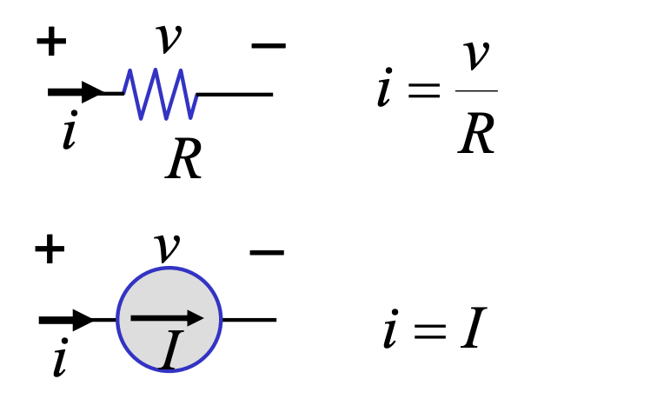
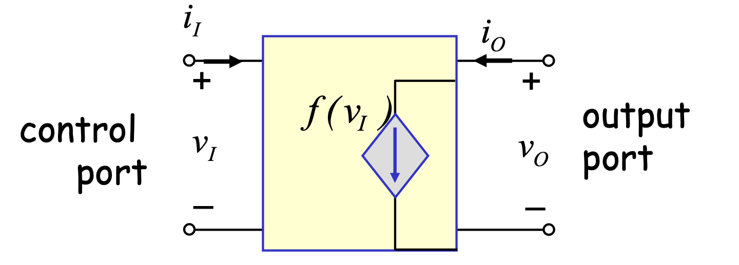
Major Difference
Independent devices:
Dependent devices:
2 terminals, 1 port
2 terminals, 2 port

Slide 5
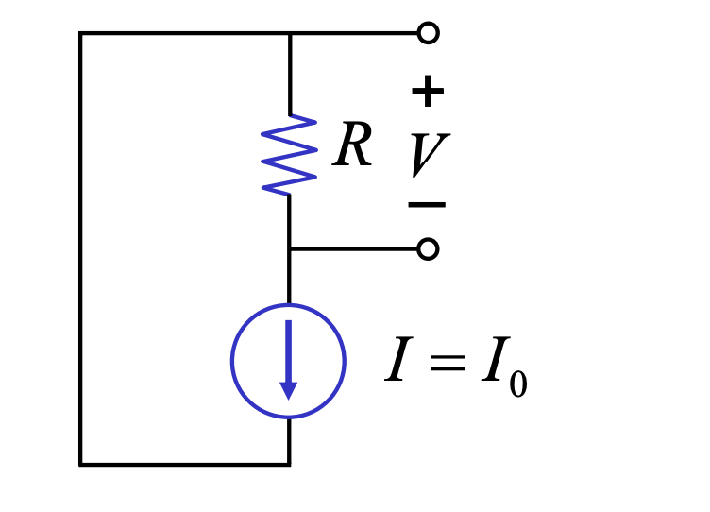
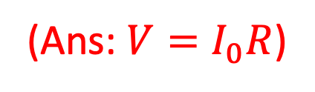
Example 1
Find V

Slide 6
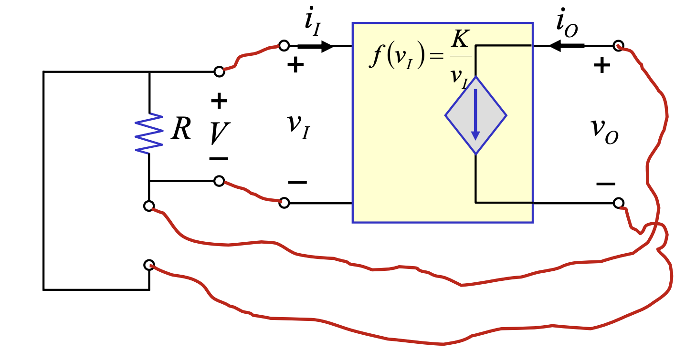
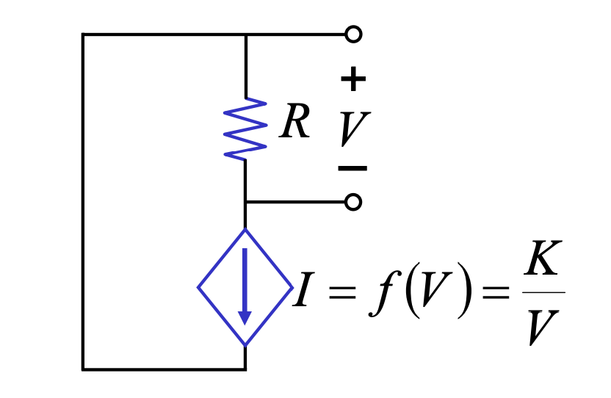
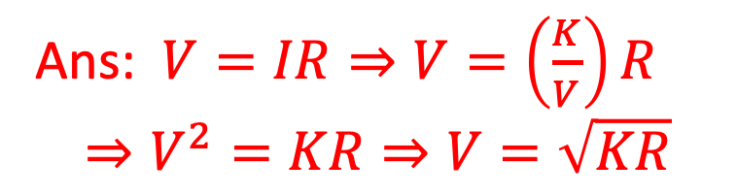
Example 2
Find V
Application of dependent sources: amplifiers!

Slide 7
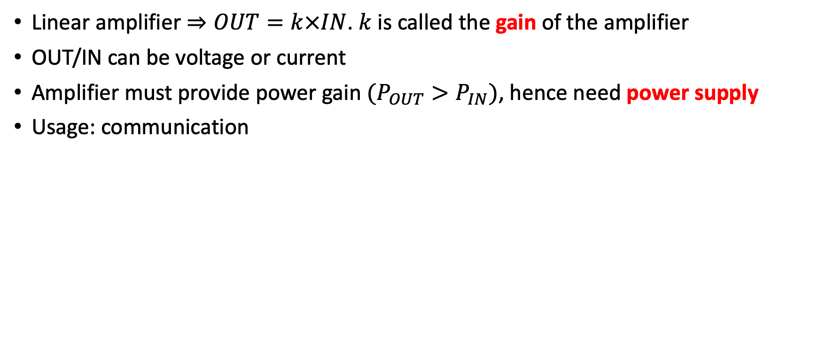
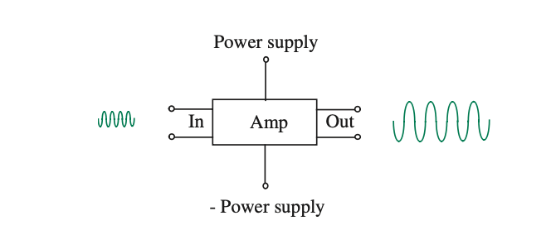
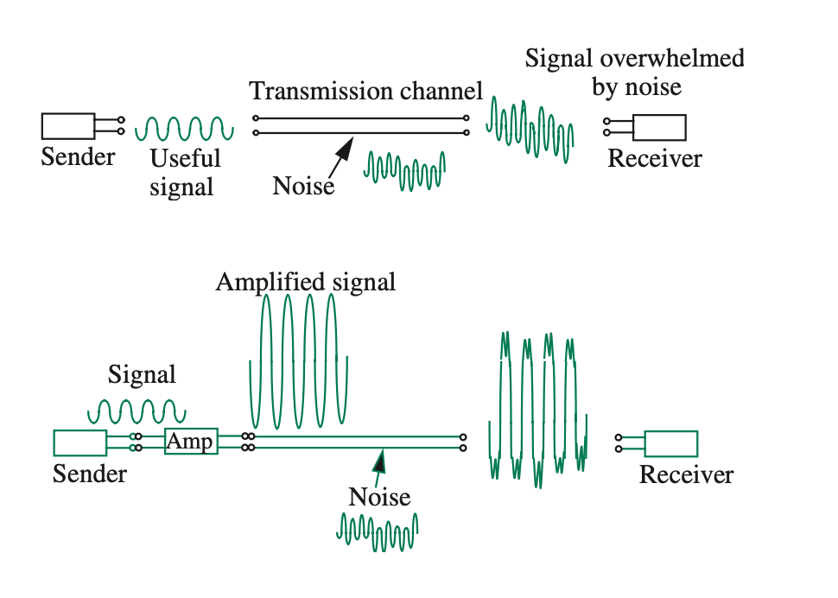
Amplifier

Slide 8
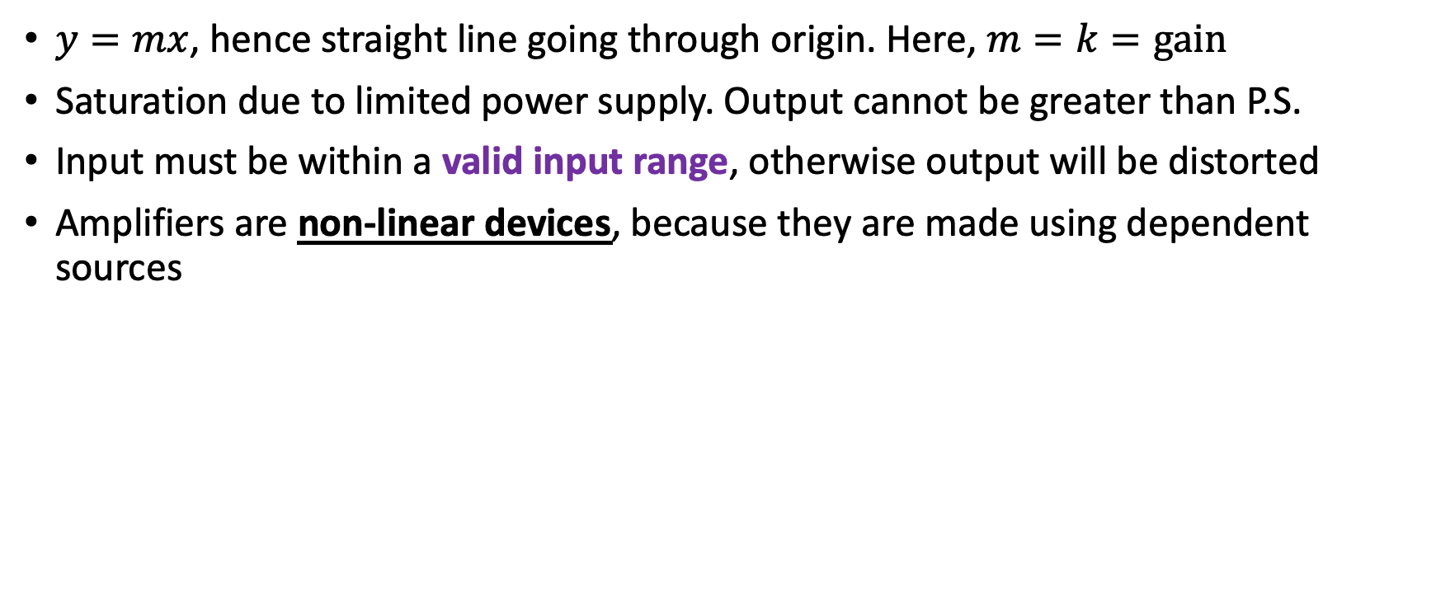
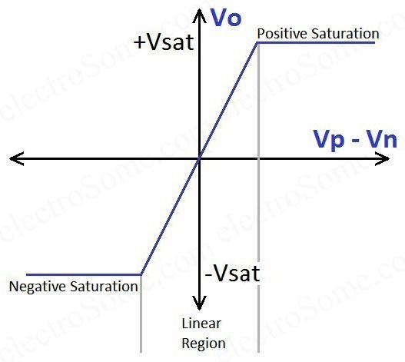
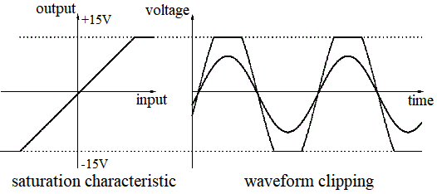
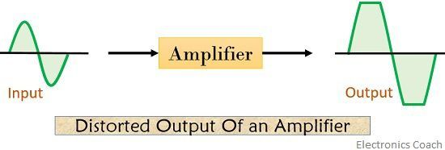
Transfer Characteristics of Amplifiers
OUT
IN

Slide 9
Operational Amplifiers
An operational amplifier, or op-amp for short, is a versatile and powerful integrated circuit that is widely used in a variety of electronic applications.
An Op-Amp is designed so that it performs some mathematical operations when external components, such as resistors and capacitors, are connected to its terminals.
The op amp is an electronic device consisting of a complex arrangement of resistors, transistors, capacitors, and diodes. A full discussion of what is inside the op amp is beyond the scope of this course. For now, it will suffice to treat the op amp as a circuit building block and simply study what takes place at its terminals.

Slide 10
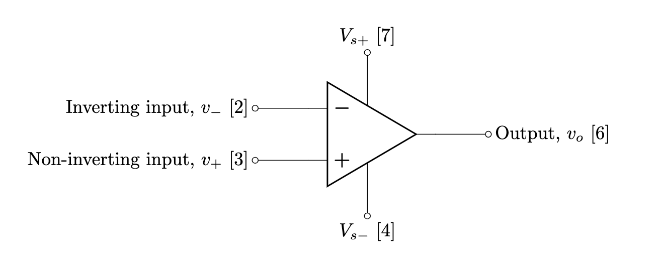
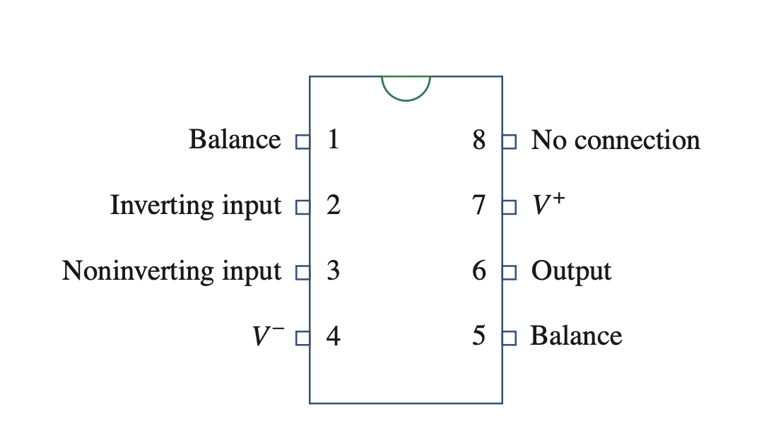
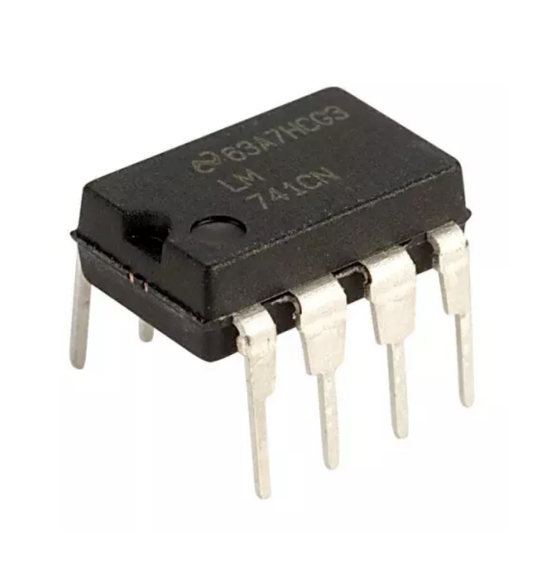
Terminals and Circuit Symbol
Op-amps are differential amplifiers – meaning it amplifies the voltage difference between two terminals. Therefore, it has two inputs
Since this is an amplifier, there are two terminals for power supply

Slide 11

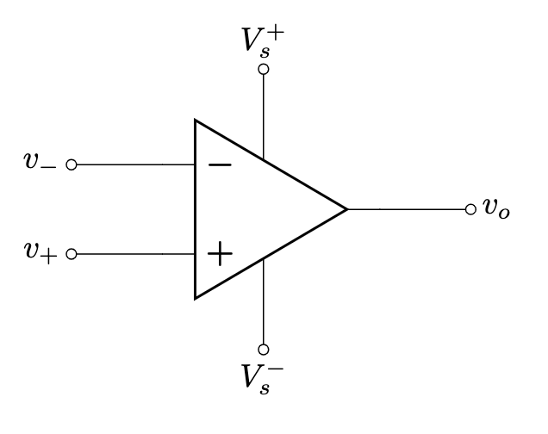
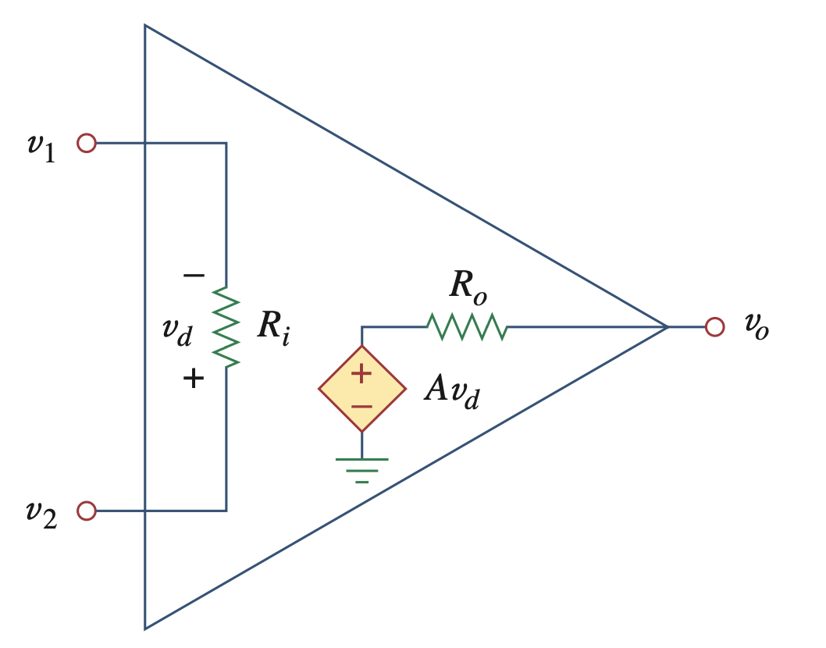
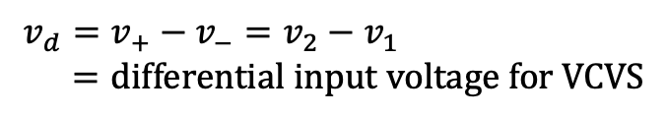



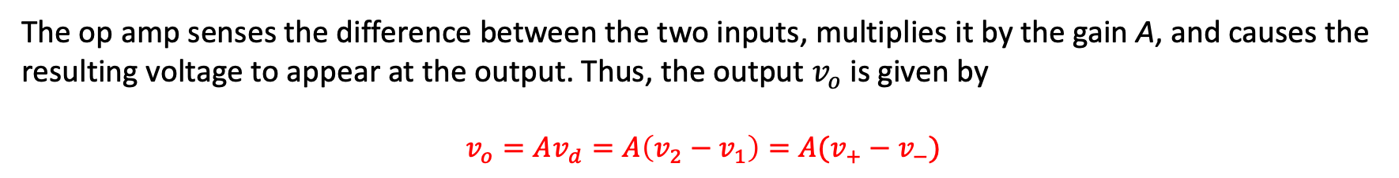
Equivalent Circuit
Since op amp is an amplifier, the internal circuit can be modeled using a voltage controlled voltage source (VCVS)! (actual circuit is complicated)

Slide 12

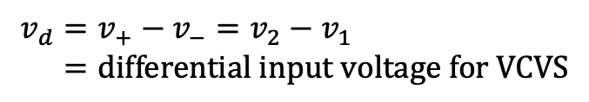

Equivalent Circuit
Since op amp is an amplifier, the internal circuit can be modeled using a voltage controlled voltage source (VCVS)! (actual circuit is complicated)
Parameter | Typical Range

Slide 13
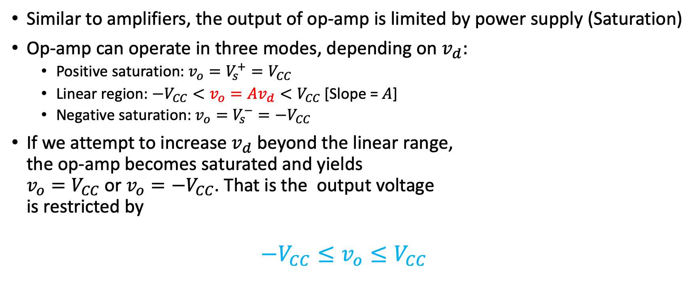
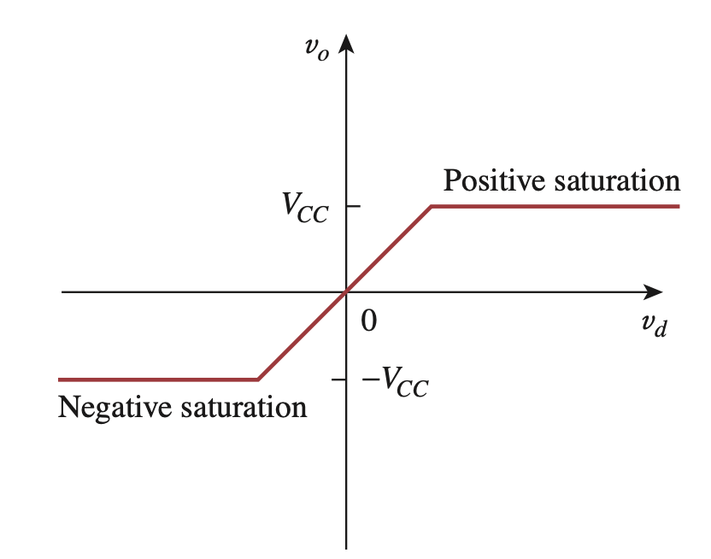
Practical Limitation - Saturation

Slide 14

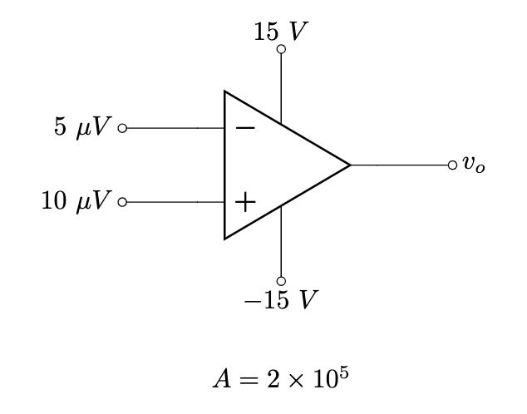
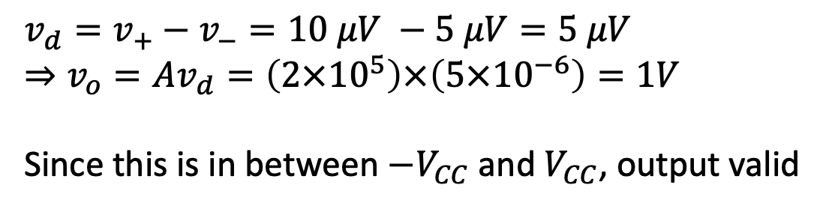
Example 3
Solution:

Slide 15
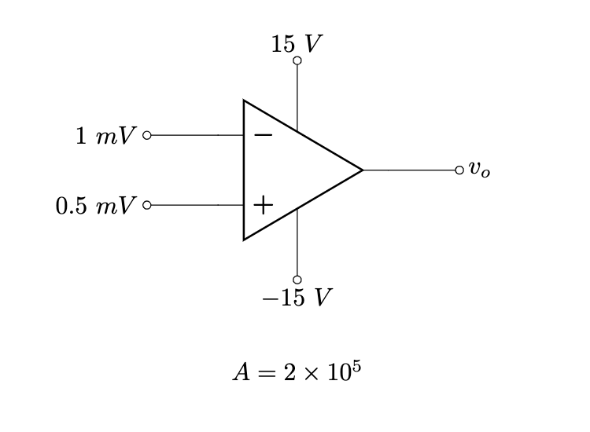
Example 4
Solution:
v_{d} = v⁺-v⁻ = 0.5 mV - 1 mV = -0.5 mV
➙ v_{o} = Av_{d} = (2x10⁵)x(-0.5x10⁻³) = -100V
However, the output must be limited within the range of -V_{CC} to +V_{CC}. Therefore, the highest output voltage can be -15V.
∴ v_{o} = -15V

Slide 16
Solving Circuit with Op-Amp
Don’t be scared! Circuit solving with op-amp is exactly same as the circuits you solved in CSE250
Step 1: replace with equivalent circuit
Step 2: solve using KCL & KVL, or nodal analysis (linear)
In most cases, the power supply voltages are not mentioned. Hence, we will assume the output is within the linear range in this case

Slide 17
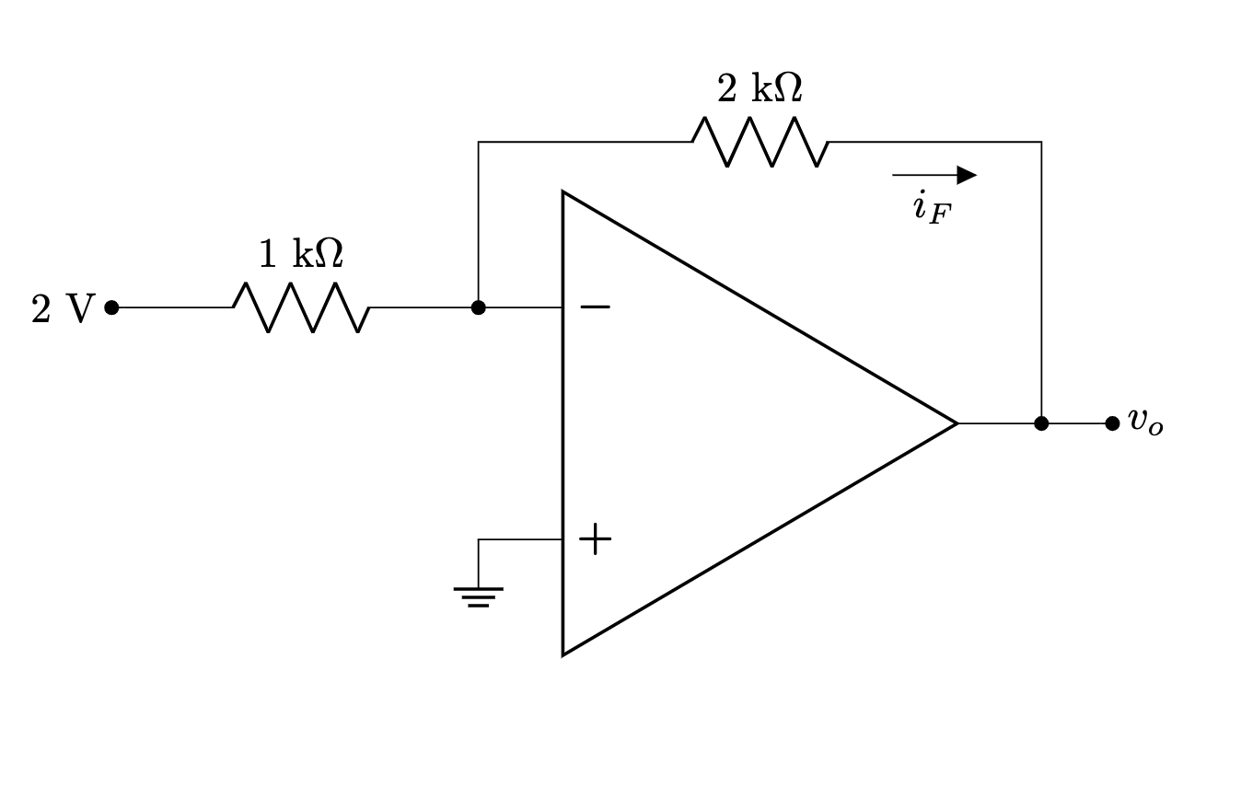
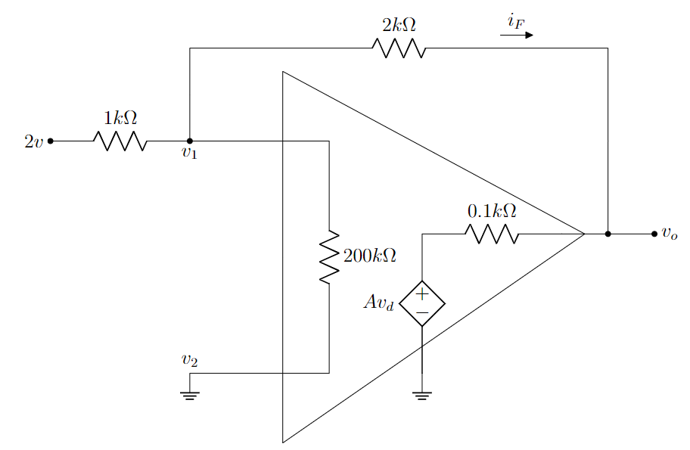
Example 5
Solution:
Step 1: replace using equivalent circuit

Slide 18
Example 5
Applying KCL we get,
i₁= i₂+ i_{F}
➙ (2-v₁)/(1k) = (v₁-v₂)/(200k)+(v₁-v_{o})/(2k)
➙ (2-v₁)/(1k) = (v₁-0)/(200k)+(v₁-v_{o})/(2k)
➙ (2-v₁)/(1k) = v₁/(200k)+(v₁-v_{o})/(2k)........(i)
Step 2: Solve using KCL & KVL or nodal
Again, from the figure,
i_{0.1k} = i_{F}
➙ (v_{o}- Av_{d})/(0.1k) = (v₁-v_{o})/(2k)
➙ (v_{o}- (2x10⁵)x(v₂-v₁))/(0.1k) = (v₁-v_{o})/(2k)
➙ (v_{o}- (2x10⁵)x(0-v₁))/(0.1k) = (v₁-v_{o})/(2k)
➙ (v_{o}- (2x10⁵)x(-v₁))/(0.1k) = (v₁-v_{o})/(2k)...(ii)
i₁
i₂
We can get v₁ and v_{o} by solving equation (i) and (ii)

Slide 19
Example 5
Step 2: Solve using KCL & KVL or nodal

Slide 20
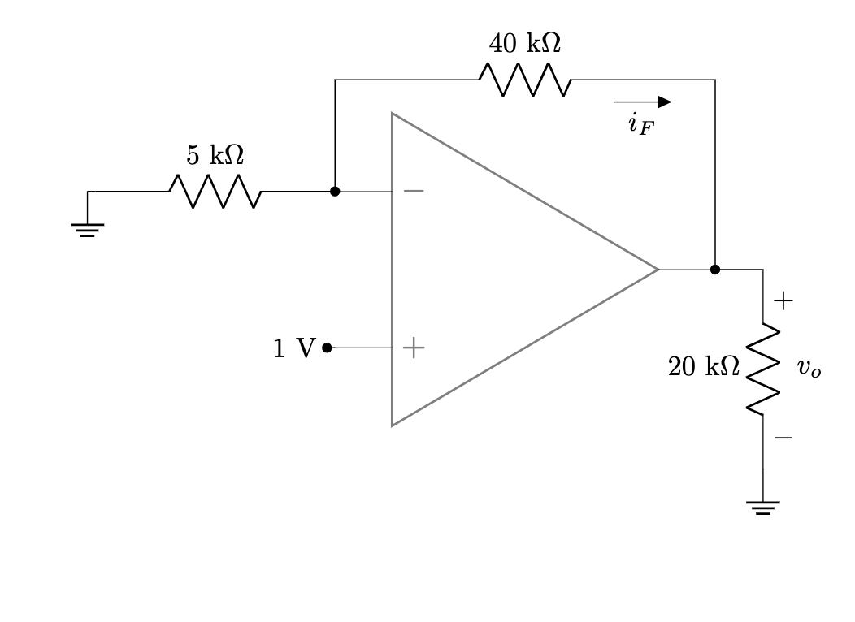
Example 6

Slide 21
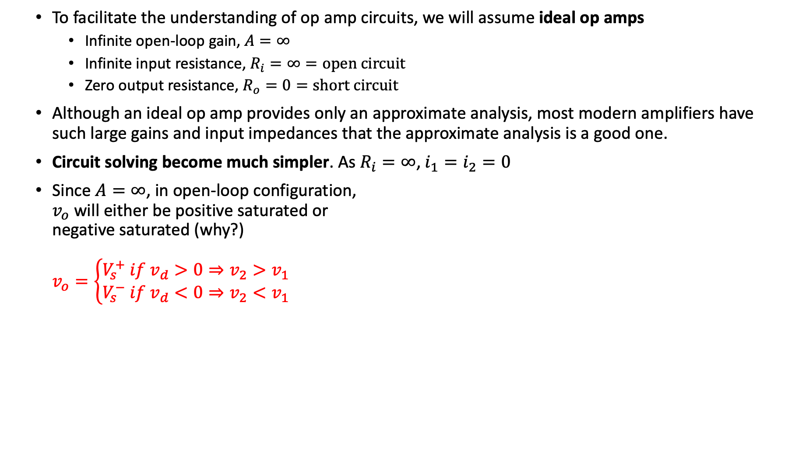

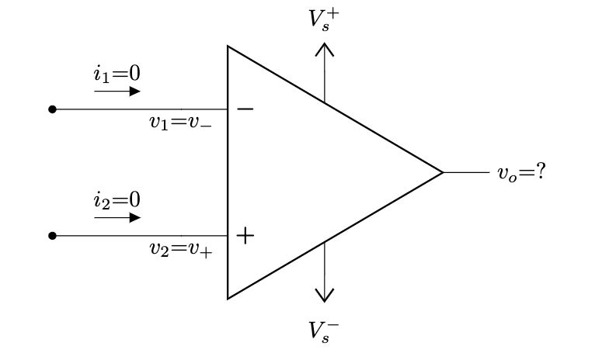




The Ideal Op-Amp
VTC of ideal op amp

Slide 22
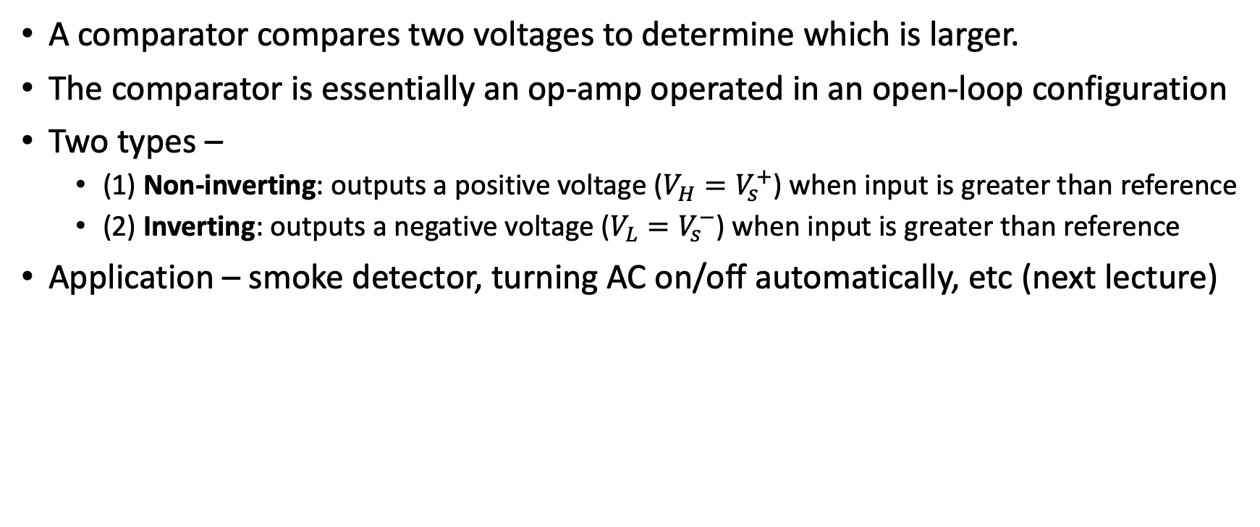
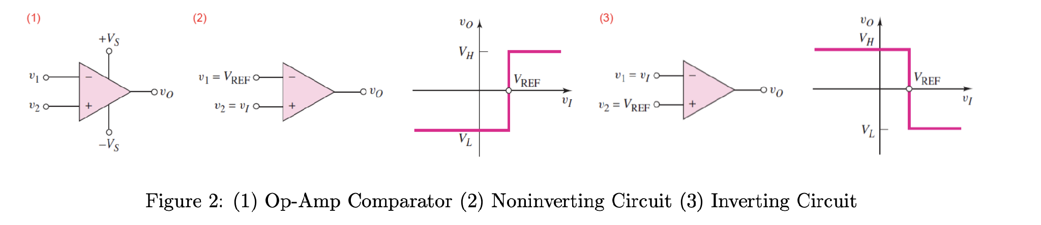
Application - Comparator

Slide 23
Lecture 4
Op Amp – Part 2

Slide 24

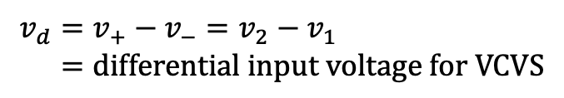




Review – Operational Amplifier

Slide 25
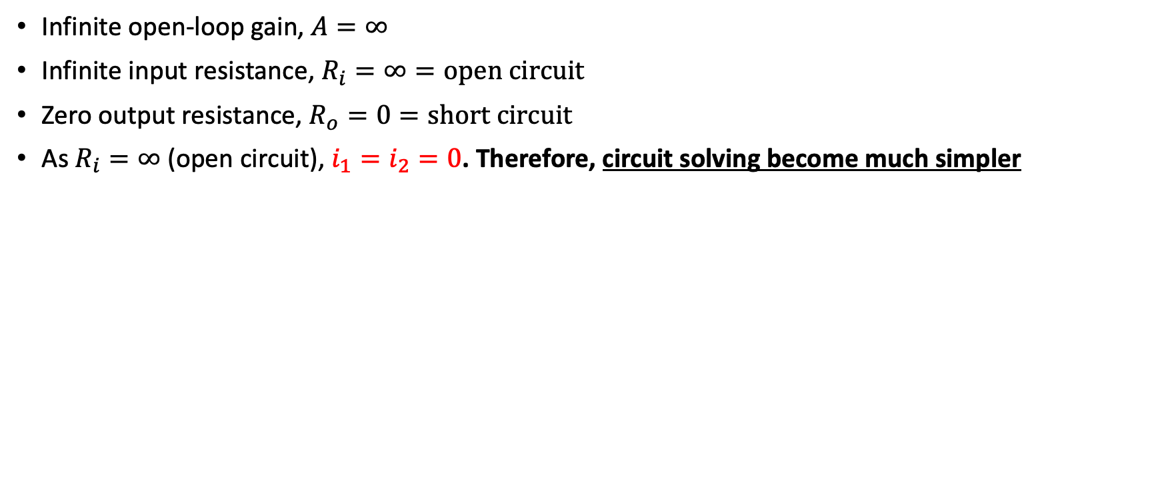

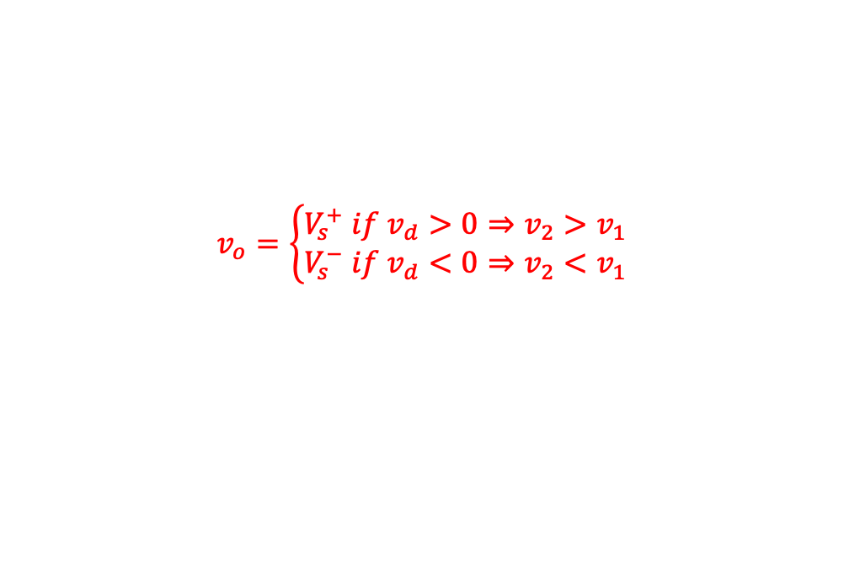


Review – Ideal Op Amp
VTC of ideal op amp

Slide 26
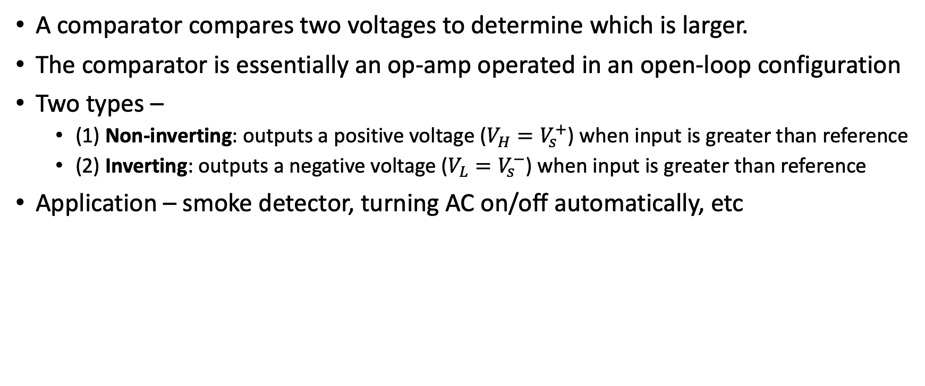
Application of Ideal Op Amp - Comparator

Slide 27
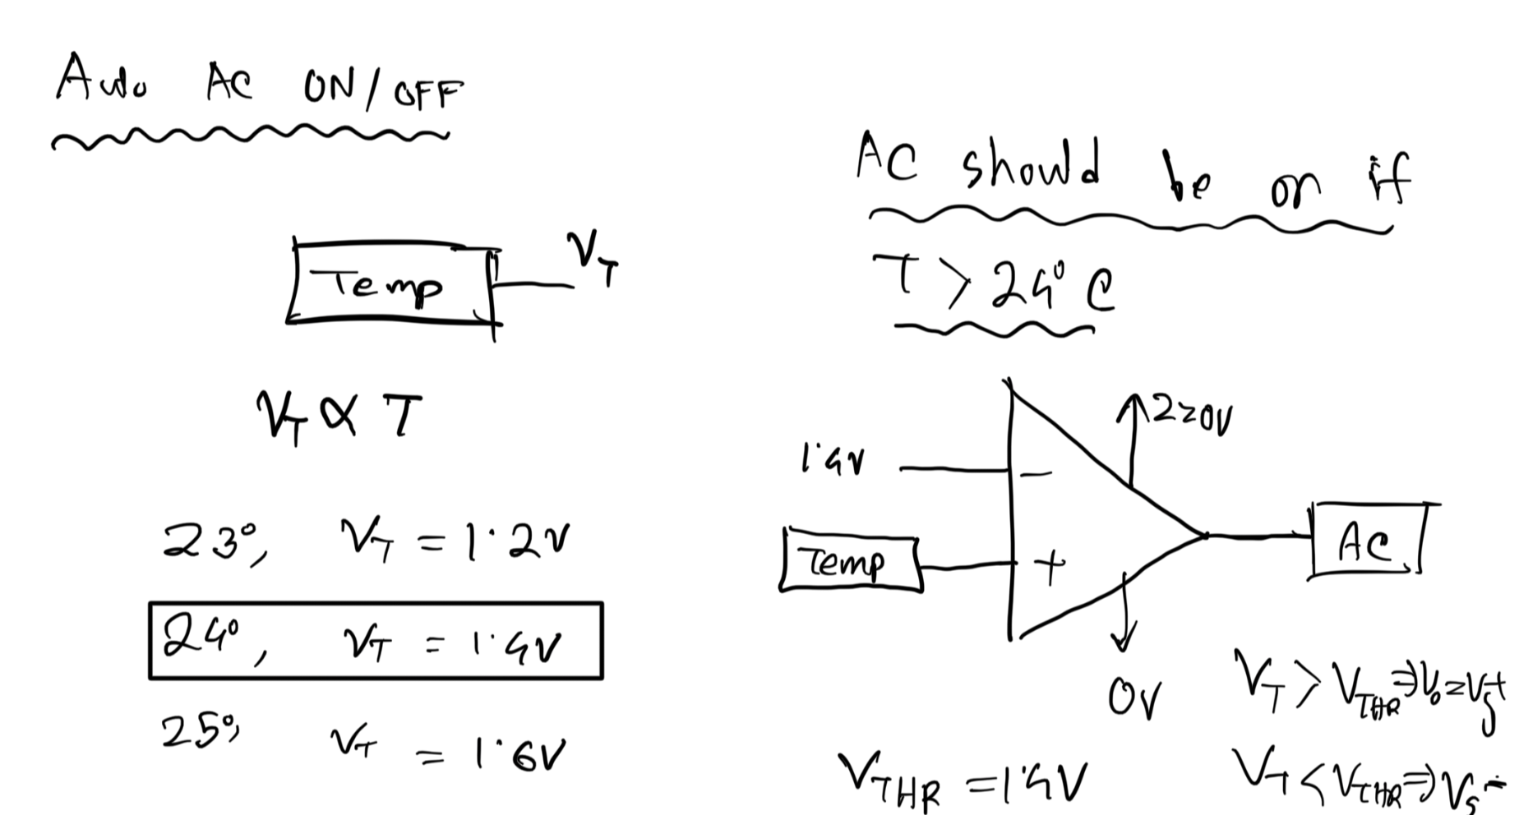
Comparator Application – Automatic AC
Sensor
Sensor

Slide 28
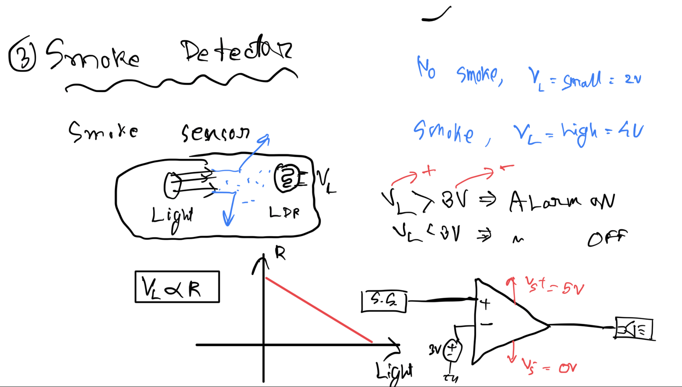
Smoke Detector

Slide 29

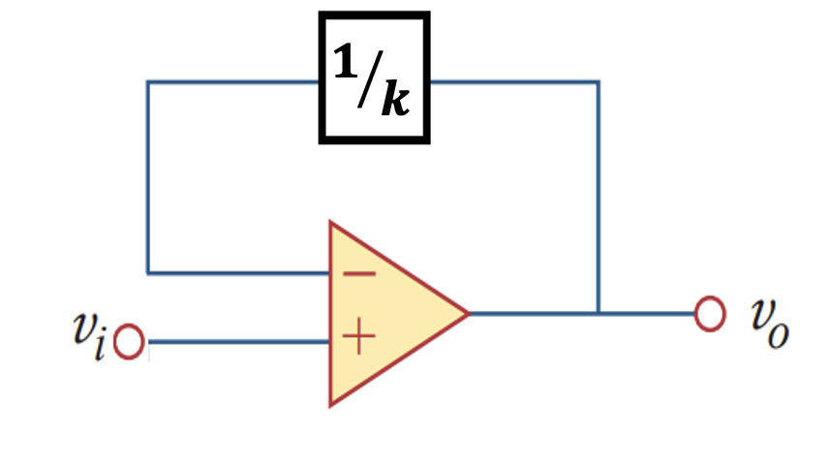
Introducing Negative Feedback
The gain (A) of an ideal op amp is infinity, practically extremely large.
The power supply (+Vs and –Vs) limits the op amp's output.
We require a method to have a finite gain. That is what negative feedback does.
Negative feedback: feeding back a portion of output to inverting input
Idea – the output will become stable due to a self-correcting mechanism

Slide 30
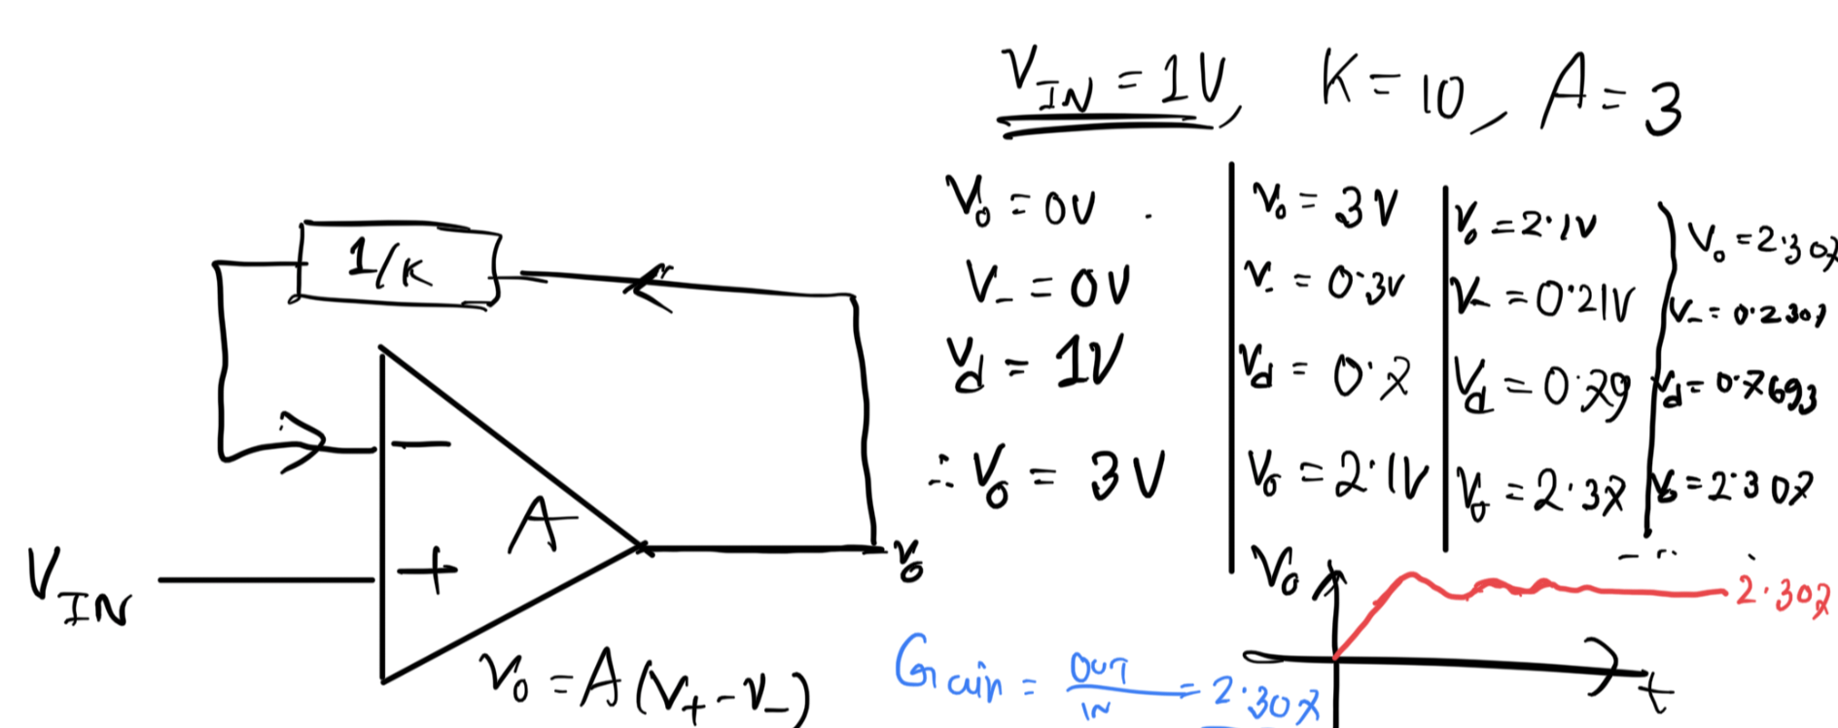
Negative Feedback – Numerical Example

Slide 31
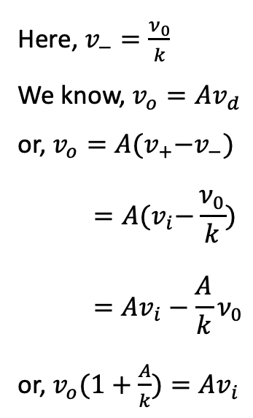
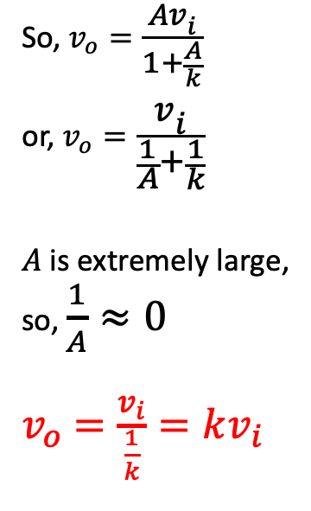
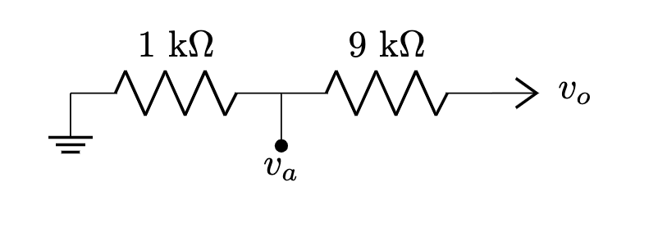
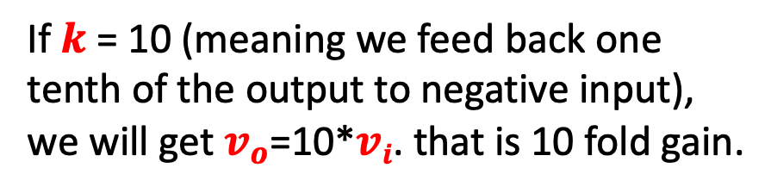
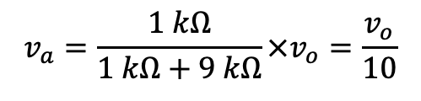
Negative Feedback – Derivation of Gain
How to get 1/k of output to input? Voltage dividers!

Slide 32
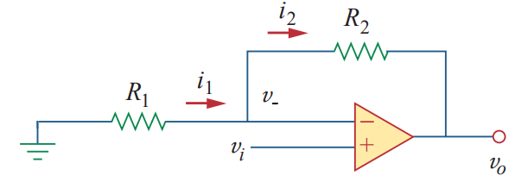


Inverting Amplifier

Slide 33
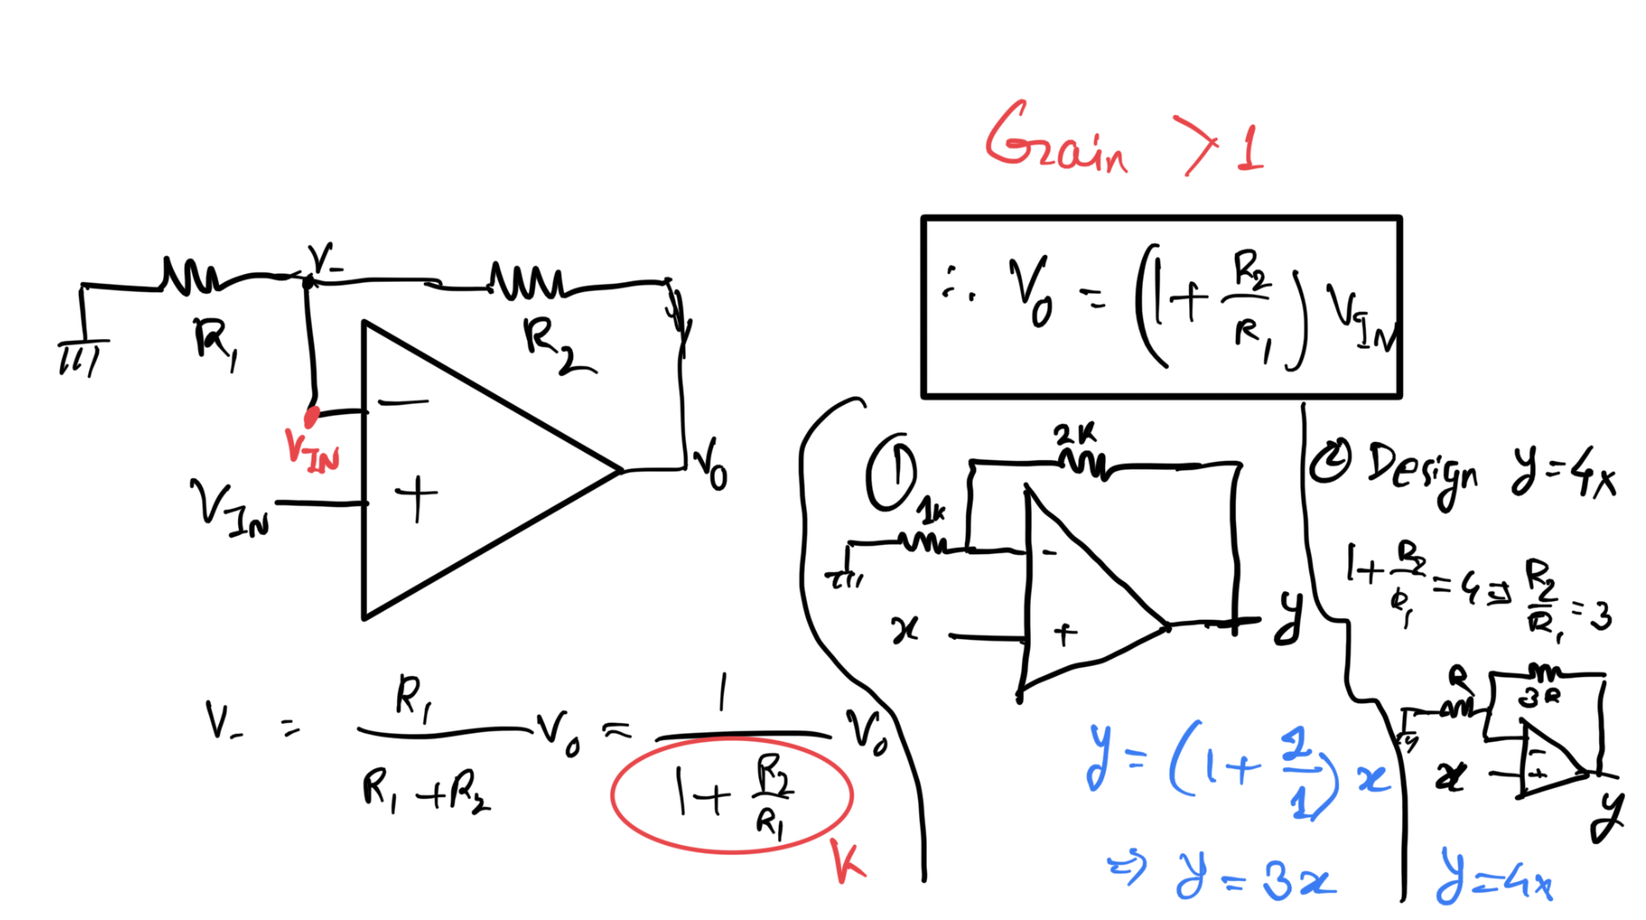
Inverting Amplifier

Slide 34
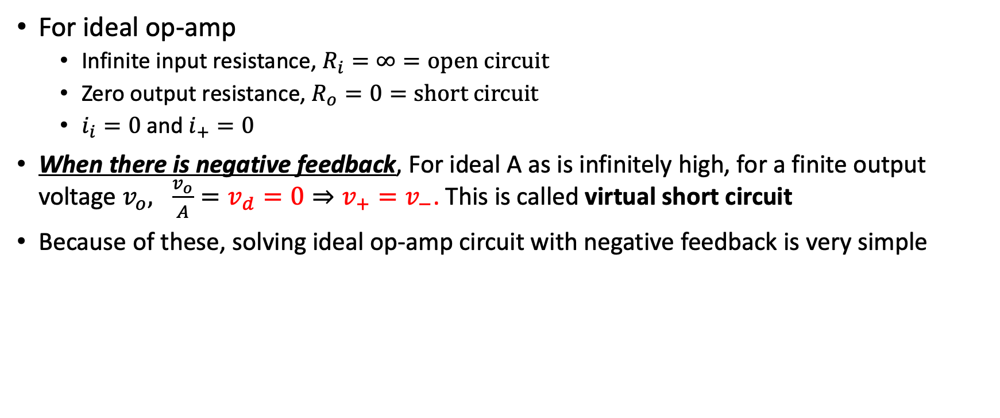
Solving Circuit with Ideal Op Amp + NF

Slide 35


Example – Inverting Amplifier

Slide 36





Example – Inverting Amplifier

Slide 37




General

Slide 38

Example

Slide 39
Lecture 5
Op Amp – Part 3

Slide 40

Solving Circuit with Ideal Op Amp + NF

Slide 41
Review – Inverting Amplifier

Slide 42
Example – Inverting Amplifier

Slide 43
Example

Slide 44






Inverting Adder

Slide 45

Example
Implement the following function using op-amps:

Slide 46













Op Amp as Differentiator
Review – Capacitor

Slide 47





Op Amp as Integrator

Slide 48



Example

Slide 49


Example
Analyze the circuit below to find an expression of f in terms of inputs x and y.

Slide 50
Op Amp as Comparator
A comparator compares two voltages to determine which is larger.

